Slide 1

Sentiment Analysis of Twitter Dataset
This project leverages Twitter data to uncover sentiment trends using both rule-based (VADER) and machine-learning approaches. By employing Natural Language Processing (NLP) techniques, we classify tweets as positive, negative, or neutral to derive actionable insights.
Our analysis of 10,000 tweets combines sentiment classification with topic modeling to provide a holistic overview of public sentiment. The project compares rule-based sentiment analysis with machine-learning approaches and extracts key topics through clustering methods.

Slide 2

Dataset Overview
Dataset Size
Key Attributes
Engagement Metrics
10,000 tweets with no missing values
Tweet_ID, Username, Text, Retweets, Likes, Timestamp
Average Retweets: 49.72; Average Likes: 49.93
The dataset was sourced from a publicly available repository and includes unique identifiers for each tweet, the Twitter account that posted it, the content, engagement metrics, and posting time. Cleaning and transformation were performed to convert the Timestamp column into a datetime format for trend analysis.

Slide 3
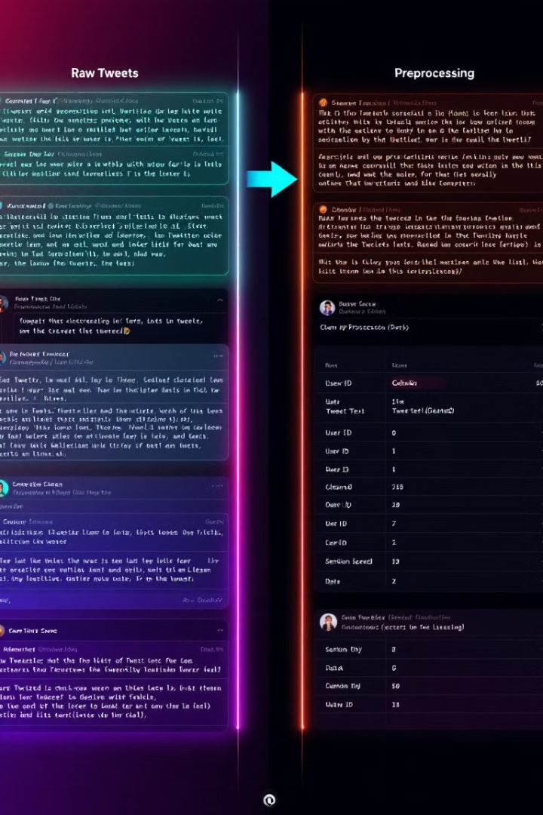




Data Preprocessing Steps
Missing Values Check
Identified and handled null values in the dataset
Text Cleaning
Lowercased text, removed mentions, URLs, hashtags, special characters, and stopwords
Tokenization & Lemmatization
Processed text for semantic analysis
Feature Engineering
Created Cleaned_Text column and extracted Date from Timestamp
To ensure high-quality input data for analysis, we performed comprehensive preprocessing. This transformation is illustrated in the example: Raw text "Party least receive say or single. Prevent pre..." became the cleaned version "party least receive say single prevent pre".

Slide 4

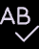


Rule-Based Sentiment Analysis
VADER Approach
Sentiment Scoring
Used Valence Aware Dictionary and sEntiment Reasoner for classification based on predefined lexicons
Assigned Positive (≥0.05), Negative (≤-0.05), or Neutral (in between) scores to tweets
Performance
Achieved 100% accuracy on the dataset (expected for rule-based approaches)
The VADER tool provides a straightforward approach to sentiment analysis by using a dictionary-based method. While it achieved perfect accuracy on our dataset, this doesn't account for potential generalization issues with new or out-of-vocabulary words.

Slide 5










Topic Modeling Results
Politics
Education
Keywords related to political discourse
Keywords: "teacher," "education," "pass"
Personal Experiences
Keywords about daily life and personal stories
Entertainment
Keywords about media, celebrities, and leisure
Technology
Keywords about tech innovations and digital trends
To identify recurring themes in tweets, we used TF-IDF combined with K-Means clustering with 5 clusters. Word clouds were generated for each cluster to illustrate the prominent words discussed in tweets, providing visual representation of key topics.

Slide 6
Machine Learning Sentiment Classification
Models Tested
Performance Metrics
Logistic Regression
Model
Precision
Recall
F1-Score
Accuracy
Decision Trees
Random Forest
Logistic Regression
0.86
0.94
0.89
86.10%
All models were trained on TF-IDF vectorized tweet data to transform text into numerical features.
Random Forest
0.80
1.00
0.89
80.00%
SVM
0.83
1.00
0.91
83.00%
VADER
-
-
-
100%
Logistic Regression emerged as the best-performing model with 86.10% accuracy. While this is lower than VADER's perfect score, machine learning approaches offer better generalization to new data and can adapt to changing language patterns.

Slide 7

Visualizations & Insights
79%
16%
Positive Tweets
Negative Tweets
Majority of analyzed content
Second most common sentiment
5%
Neutral Tweets
Smallest sentiment category
Sentiment patterns showed spikes correlating with notable events like holidays and breaking news. Line plots were used to display sentiment trends and engagement metrics by date. We also calculated an engagement score using the formula: Engagement Score = Retweets + (2 × Likes) to identify the most impactful tweets.

Slide 8




Conclusions & Future Scope
Deep Learning Approaches
Implement LSTM, BERT, or GPT-based models
Enhanced Topic Modeling
Use LDA for finer-grained topics
Real-Time Analytics
Employ Twitter's API for live tracking
Improved Sentiment Detection
Add sarcasm and emoji-based classification
This project successfully classified tweet sentiments using both rule-based and machine learning models. The machine learning approach exhibited greater robustness, achieving an accuracy of 86.10% with Logistic Regression, while topic modeling added depth by segmenting tweets into key themes.

